Slide 1
NIRS Update Extravaganza
Ben Richardson
Weekly Update 4/19/2024

Slide 2
Status of all projects
Broadband ILD fNIRS (SRM-NIRS-EEG-1)
Magnified ILD fNIRS (MILD2)
fNIRSandGerbils/ASFdgajkghwoauef with Emaya

Slide 3
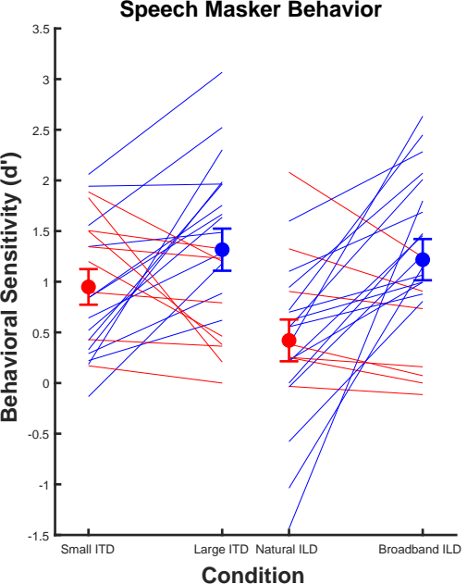
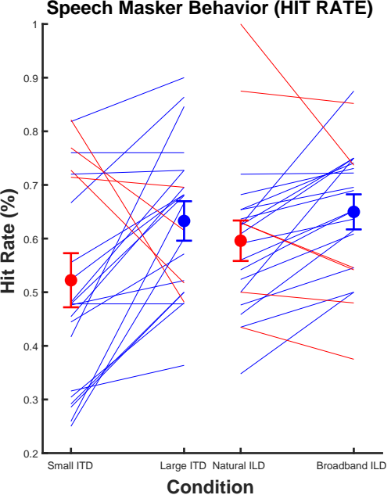
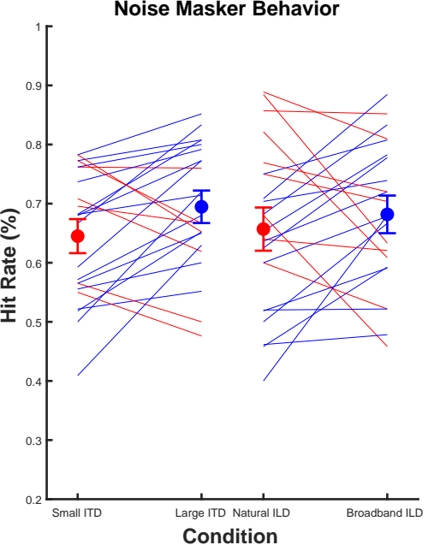
SRM-NIRS-EEG Behavior

Slide 4
SRM-NIRS-EEG Speech Results

Slide 5
SRM-NIRS-EEG Noise Results

Slide 6
ANOVA on Behavior (hit rate only)
Main Factors: Spatial Condition, Masker Type (speech vs. noise)

Slide 7
ANOVA on mean HbO
Main Factors: Spatial Condition, Masker Type (speech vs. noise)

Slide 8
ANOVA on Beta

Slide 9
MILD-2 Task and Behavior

Slide 10
MILD-2 NIRS Results

Slide 11
EEG Project status of pilot/considerations

